Slide 1
Data Structure and Algorithm (PMSCS 623P)
Lecture 12
Greedy Algorithms

Slide 2
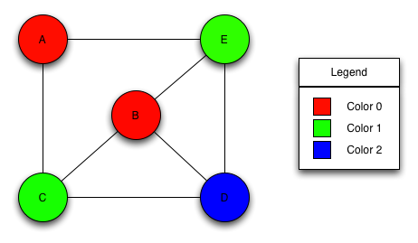
Types of Computational Problems
Decision Problems:
3-coloring decision problem: given an undirected graph, G= (V,E), determine if there is a way to assign a “color” chosen from {0, 1, 2} to each vertex in such a way that no two adjacent vertices have the same color
Path decision problem: Is there any path from u to v in G?

Slide 3
Types of Computational Problems
Search problem:
3-coloring search problem: given an undirected graph G = (V, E) find, if it exists, a coloring c: V → {1, 2, 3} of the vertices, such that for every (u, v) ∈ E: c(u) ≠ c(v)
Path search problem: Find all the paths from u to v in G
a
b
Find all the paths from a to d:
a →b →d
a →c →d
a →b →c →d
d
c

Slide 4
Types of Computational Problems
Counting Problem: Compute the number of solutions to a given search problem
3-coloring counting problem: given an undirected graph G = (V, E) compute the number of ways we can color the graph using only 3 colors: {1,2,3}. While coloring we have to ensure that no two adjacent vertices have the same color.
Path counting Problem: Compute the number of possible paths from u to v in a given graph G.
a
b
Compute the number of paths from a to d: 3
d
c

Slide 5
Types of Computational Problems
Optimization Problems: Find the best possible solution among the set of all possible solutions to a search problem
Graph coloring optimization problem: given an undirected graph, G= (V,E), what is the minimum number of colors required to assign “colors” to each vertex in such a way that no two adjacent vertices have the same color
Path optimization problem: Find the shortest path(s) from u to v in a given graph G.
a
b
Find all the shortest paths from a to d:
a →b →d
a →c →d
d
c

Slide 6
Greedy Algorithm
Solves an optimization problem
Example:
Activity Selection Problem
Dijkstra’s Shortest Path Problem
Minimum Spanning Tree Problem
For many optimization problems, greedy algorithm can be used. (not always)
Greedy algorithm for optimization problems typically go through a sequence of steps, with a set of choices at each step. Current choice does not depend on evaluating potential future choices or pre-solving repeatedly occurring subproblems (a.k.a., overlapping subproblems). With each step, the original problem is reduced to a smaller problem.
Greedy algorithm always makes the choice that looks best at the moment.
It makes a locally optimal choice in the hope that this choice will lead to a globally optimal solution.

Slide 7
Optimal Solution
What is an Optimal Solution?
Given a problem, more than one solution exist
One of the solution is the best based on some given constraints, that solution is called the optimal solution
What is Global Optimal Solution?
Optimal Solution to the main problem
What is local Optimal Solution?
Optimal Solution to the subproblems

Slide 8
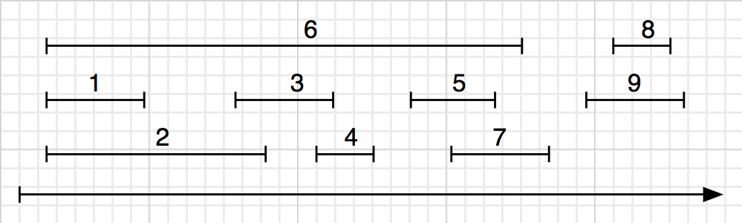
Greedy algorithms
Designing a greedy algorithm
Definition (Interval scheduling problem)
Given a set of schedules I = {I_{i} }, find the largest set A ⊆ I such that the members of A are non-conflicting.
Example
7 / 38

Slide 9
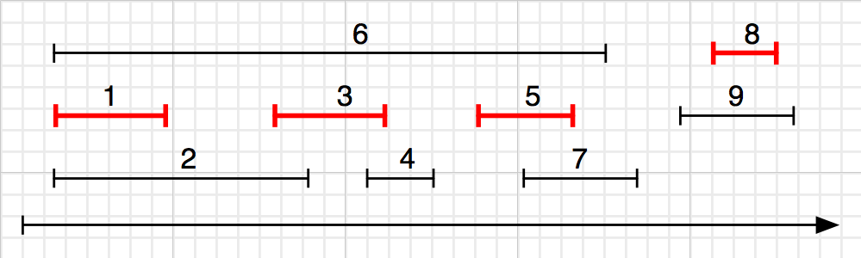
Greedy algorithms
Designing a greedy algorithm
Definition (Interval scheduling problem)
Given a set of schedules I = {I_{i} }, find the largest set A ⊆ I such that the members of A are non-conflicting.
Example
A = {1, 3, 5, 8},
|A| = 4.
7 / 38

Slide 10
Greedy algorithms
Designing a greedy algorithm
Definition (Interval scheduling problem)
Given a set of schedules I = {I_{i} }, find the largest set A ⊆ I such that the members of A are non-conflicting.
Example
A = {1, 3, 5, 8}, |A| = 4.
Question
Is this the only “correct” answer?
7 / 38

Slide 11
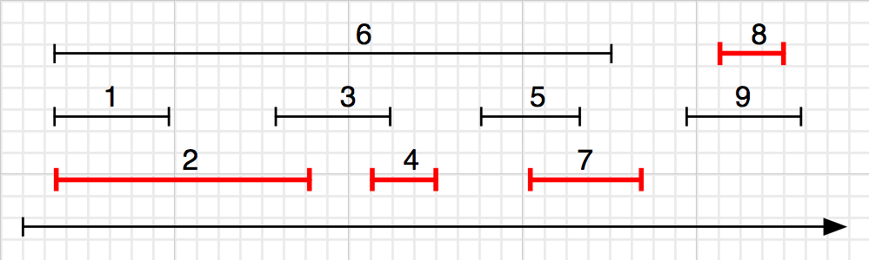
Greedy algorithms
Designing a greedy algorithm
Definition (Interval scheduling problem)
Given a set of schedules I = {I_{i} }, find the largest set A ⊆ I such that the members of A are non-conflicting.
Example
A = {1, 3, 5, 8},
Question
|A| = 4.
How about {2, 4, 7, 8}?
Licensed under
7 / 38

Slide 12
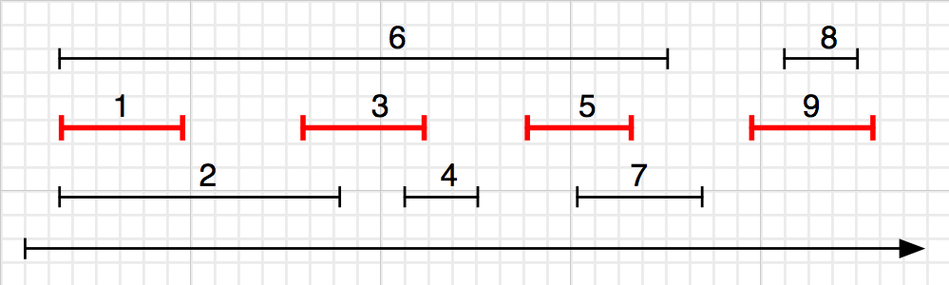
Greedy algorithms
Designing a greedy algorithm
Definition (Interval scheduling problem)
Given a set of schedules I = {I_{i} }, find the largest set A ⊆ I such that the members of A are non-conflicting.
Example
A = {1, 3, 5, 8}, |A| = 4.
Question
How about {2, 4, 7, 8}? {1, 3, 5, 9}?
7 / 38

Slide 13
Greedy algorithms
Designing a greedy algorithm
Definition (Interval scheduling problem)
Given a set of schedules I = {I_{i} }, find A ⊆ I such that the members of A are non-conflicting and |A| is maximized.
Example
A = {1, 3, 5, 8}, |A| = 4.
Question
{1, 3, 5, 8}? {2, 4, 7, 8}? {1, 3, 5, 9}? . . . How many?

Slide 14
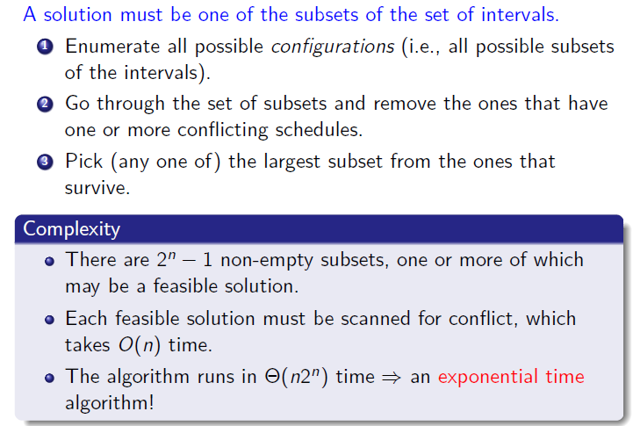
Greedy algorithms
Brute force solution

Slide 15
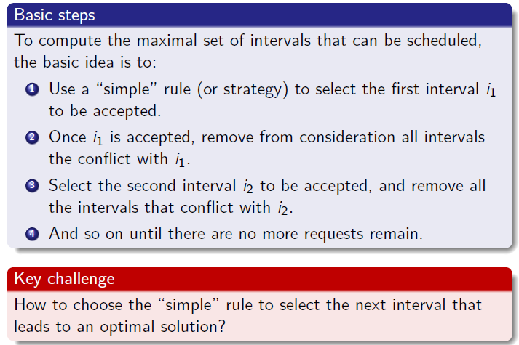
Designing a greedy algorithm
9 / 38

Slide 16
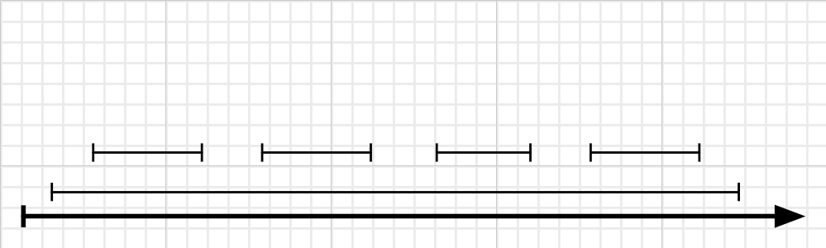
Designing a greedy algorithm (continued)
Strategy 1. Earliest First
The idea is to start using the resource as early as possible.
Sort the intervals by starting time, breaking ties arbitrarily.
Pick the first one, removing it from the list along with all the intervals that conflict with it.
Repeat Step 2, until the list is empty.
1
2
3
Example
|A| =???.
10 / 38

Slide 17
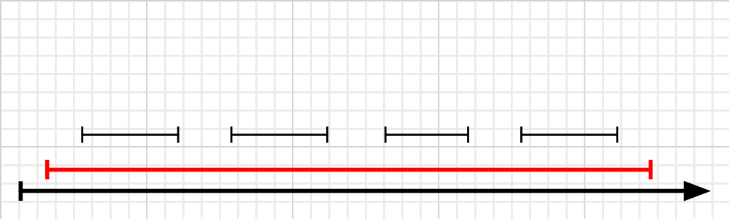
Designing a greedy algorithm (continued)
Strategy 1. Earliest First
The idea is to start using the resource as early as possible.
Sort the intervals by starting time, breaking ties arbitrarily.
Pick the first one, removing it from the list along with all the intervals that conflict with it.
Repeat Step 2, until the list is empty.
1
2
3
Example (using Earliest First strategy)
|A| = 1.
CSE 221: Algorithms
10 / 38

Slide 18
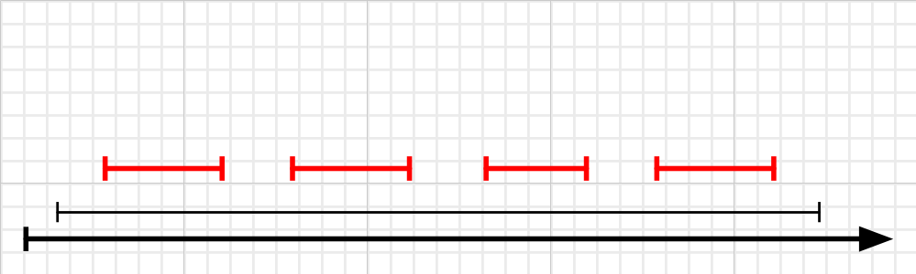
Designing a greedy algorithm (continued)
Strategy 1. Earliest First
The idea is to start using the resource as early as possible.
Sort the intervals by starting time, breaking ties arbitrarily.
Pick the first one, removing it from the list along with all the intervals that conflict with it.
Repeat Step 2, until the list is empty.
1
2
3
Example (using an optimal strategy)
|A| = 4.
CSE 221: Algorithms
10 / 38

Slide 19
Designing a greedy algorithm (continued)
Strategy 1. Earliest First
The idea is to start using the resource as early as possible.
Sort the intervals by starting time, breaking ties arbitrarily.
Pick the first one, removing it from the list along with all the intervals that conflict with it.
Repeat Step 2, until the list is empty.
1
2
3
This strategy does not lead to an optimal solution.
Example (using an optimal strategy)
|A| = 4.
CSE 221: Algorithms
10 / 38

Slide 20
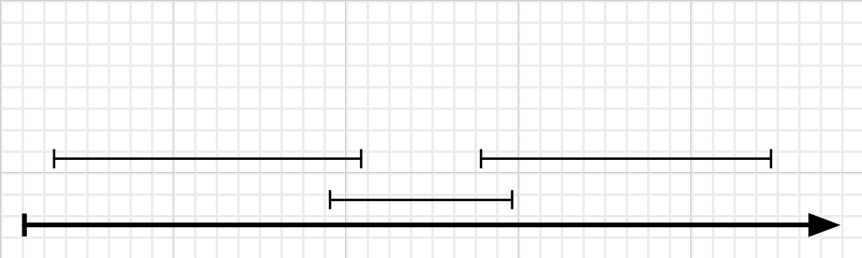
Designing a greedy algorithm (continued)
Strategy 2. Shortest First
The Earliest First strategy failed perhaps because it missed the shorter intervals, which would accommodate more intervals.
Sort the intervals by length, breaking ties arbitrarily.
Pick the first one, removing it from the list along with all the intervals that conflict with it.
Repeat Step 2, until the list is empty.
1
2
3
Example
|A| =???.
CSE 221: Algorithms
11 / 38

Slide 21
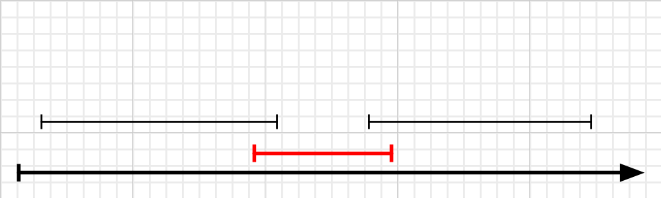
Designing a greedy algorithm (continued)
Strategy 2. Shortest First
The Earliest First strategy failed perhaps because it missed the shorter intervals, which would accommodate more intervals.
Sort the intervals by length, breaking ties arbitrarily.
Pick the first one, removing it from the list along with all the intervals that conflict with it.
Repeat Step 2, until the list is empty.
1
2
3
Example (using Shortest First strategy)
|A| = 1.
CSE 221: Algorithms
11 / 38

Slide 22
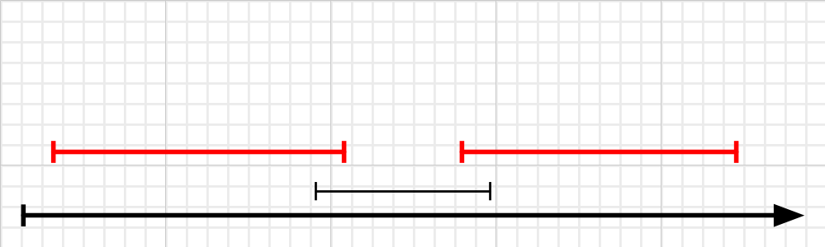
Designing a greedy algorithm (continued)
Strategy 2. Shortest First
The Earliest First strategy failed perhaps because it missed the shorter intervals, which would accommodate more intervals.
Sort the intervals by length, breaking ties arbitrarily.
Pick the first one, removing it from the list along with all the intervals that conflict with it.
Repeat Step 2, until the list is empty.
1
2
3
Example (using an optimal strategy)
|A| = 2.
CSE 221: Algorithms
11 / 38

Slide 23
Designing a greedy algorithm (continued)
Strategy 2. Shortest First
The Earliest First strategy failed perhaps because it missed the shorter intervals, which would accommodate more intervals.
Sort the intervals by length, breaking ties arbitrarily.
Pick the first one, removing it from the list along with all the intervals that conflict with it.
Repeat Step 2, until the list is empty.
1
2
3
This strategy does not lead to an optimal solution.
Example (using an optimal strategy)
|A| = 2.
CSE 221: Algorithms
11 / 38

Slide 24
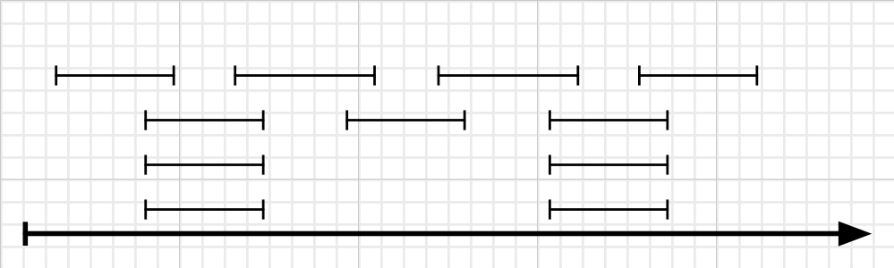
Designing a greedy algorithm (continued)
Strategy 3. Least-conflict First
The Shortest First strategy failed perhaps because the shorter ones had more conflicts, and ruled out too many intervals in the process.
Sort the intervals by the number of other intervals which conflict with it.
Pick the first one, removing it from the list along with all the intervals that conflict with it.
Repeat Step 2, until the list is empty.
1
2
3
Example
|A| =???.
CSE 221: Algorithms
12 / 38

Slide 25
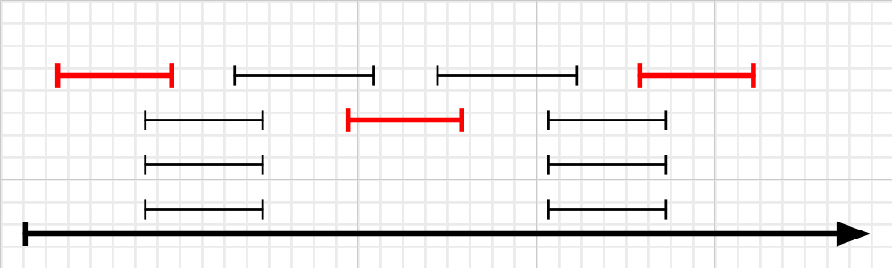
Designing a greedy algorithm (continued)
Strategy 3. Least-conflict First
The Shortest First strategy failed perhaps because the shorter ones had more conflicts, and ruled out too many intervals in the process.
Sort the intervals by the number of other intervals which conflict with it.
Pick the first one, removing it from the list along with all the intervals that conflict with it.
Repeat Step 2, until the list is empty.
1
2
3
Example (using Shortest First strategy)
|A| = 3.
CSE 221: Algorithms
12 / 38

Slide 26
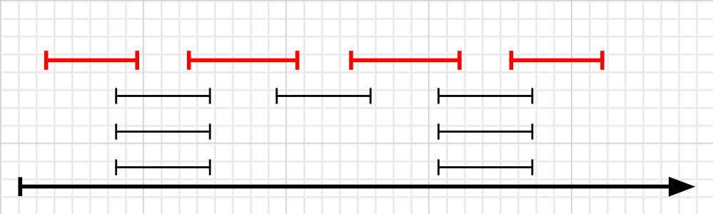
Designing a greedy algorithm (continued)
Strategy 3. Least-conflict First
The Shortest First strategy failed perhaps because the shorter ones had more conflicts, and ruled out too many intervals in the process.
Sort the intervals by the number of other intervals which conflict with it.
Pick the first one, removing it from the list along with all the intervals that conflict with it.
Repeat Step 2, until the list is empty.
1
2
3
Example (using an optimal strategy)
|A| = 4.
CSE 221: Algorithms
12 / 38

Slide 27
Designing a greedy algorithm (continued)
Strategy 3. Least-conflict First
The Shortest First strategy failed perhaps because the shorter ones had more conflicts, and ruled out too many intervals in the process.
Sort the intervals by the number of other intervals which conflict with it.
Pick the first one, removing it from the list along with all the intervals that conflict with it.
Repeat Step 2, until the list is empty.
1
2
3
This strategy does not lead to an optimal solution.
Example (using an optimal strategy)
|A| = 4.
CSE 221: Algorithms
12 / 38

Slide 28
Designing a greedy algorithm (continued)
Strategy 4. Finish First
The idea is to free up the resource as early as possible.
Sort the intervals by the finishing time, breaking ties arbitrarily.
Pick the first one, removing it from the list along with all the intervals that conflict with it.
Repeat Step 2, until the list is empty.
1
2
3
Example
|A| =???.
CSE 221: Algorithms
13 / 38

Slide 29
Designing a greedy algorithm (continued)
Strategy 4. Finish First
The idea is to free up the resource as early as possible.
Sort the intervals by the finishing time, breaking ties arbitrarily.
Pick the first one, removing it from the list along with all the intervals that conflict with it.
Repeat Step 2, until the list is empty.
1
2
3
Example (using optimal Finish First strategy)
|A| = 4.
CSE 221: Algorithms
13 / 38

Slide 30
Designing a greedy algorithm (continued)
Strategy 4. Finish First
The idea is to free up the resource as early as possible.
Sort the intervals by the finishing time, breaking ties arbitrarily.
Pick the first one, removing it from the list along with all the intervals that conflict with it.
Repeat Step 2, until the list is empty.
1
2
3
This strategy is the one that works.
Example (using optimal Finish First strategy)
|A| = 4.
CSE 221: Algorithms
13 / 38

Slide 31
Designing a greedy algorithm (continued)
Strategy 4. Finish First
The idea is to free up the resource as early as possible.
Sort the intervals by the finishing time, breaking ties arbitrarily.
Pick the first one, removing it from the list along with all the intervals that conflict with it.
Repeat Step 2, until the list is empty.
1
2
3
This strategy is the one that works. But can you prove that it works?
Example (using optimal Finish First strategy)
|A| = 4.
CSE 221: Algorithms
13 / 38

Slide 32
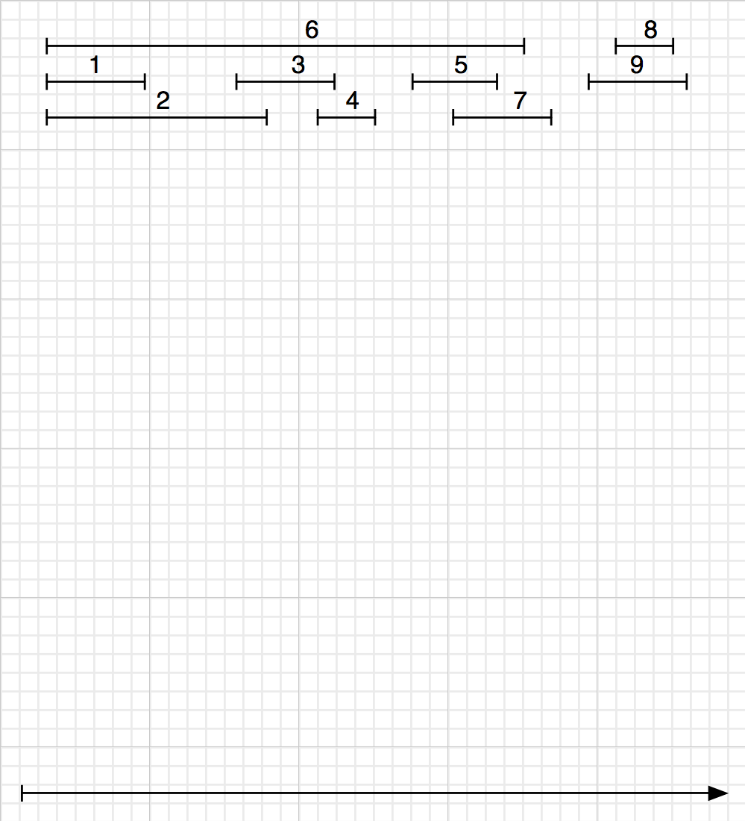
Interval scheduling in action
14 / 38

Slide 33
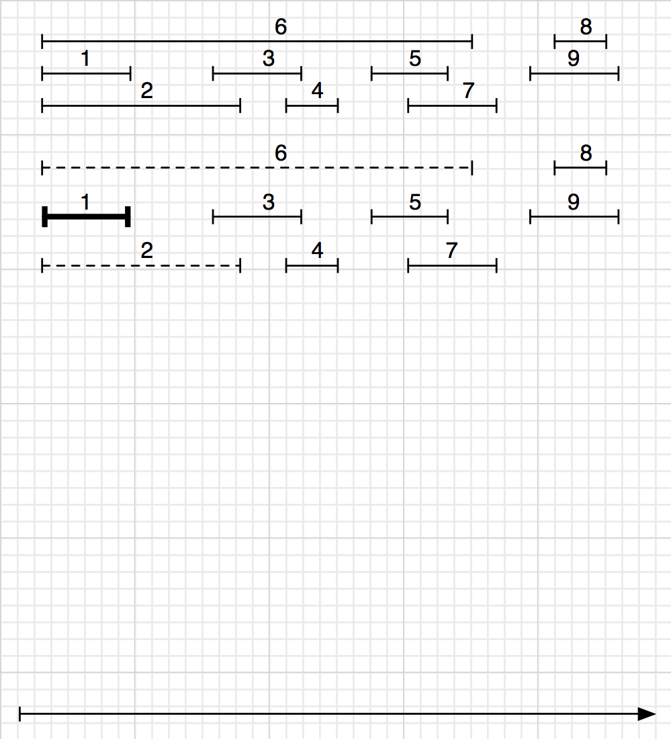
Interval scheduling in action
14 / 38

Slide 34
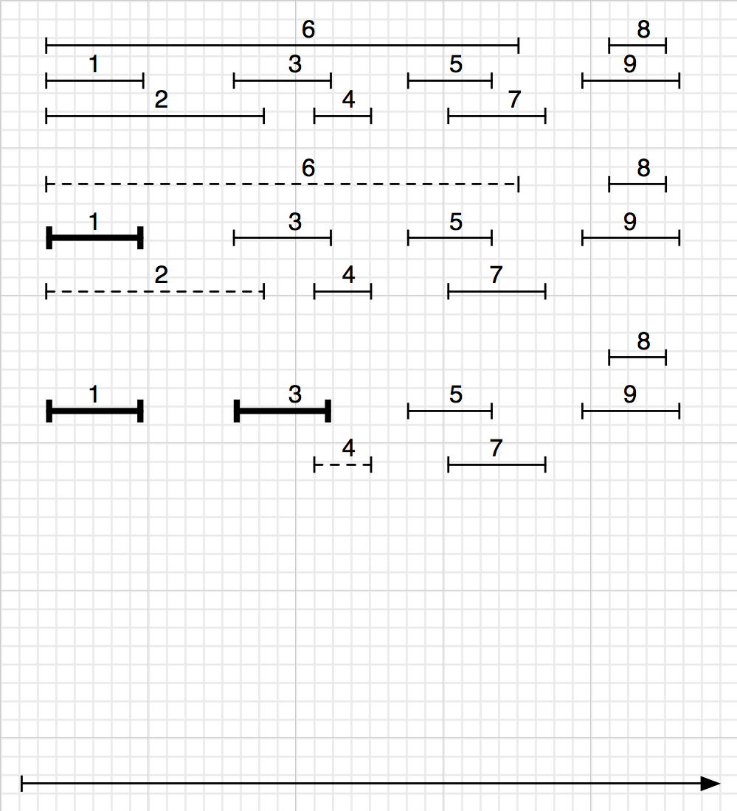
Interval scheduling in action
14 / 38

Slide 35
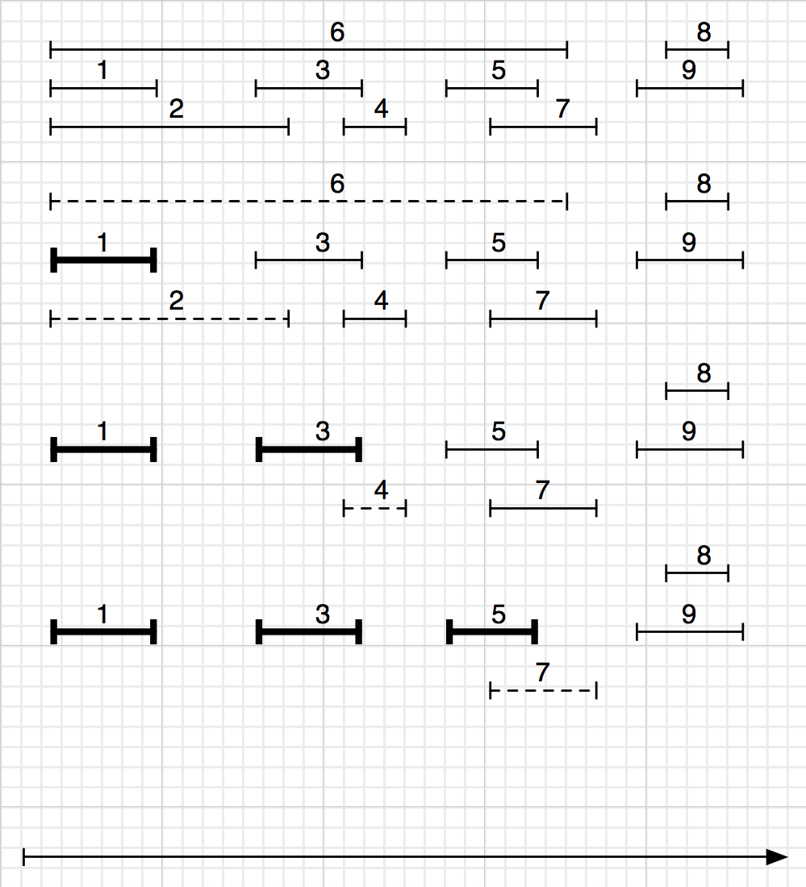
Interval scheduling in action
14 / 38

Slide 36
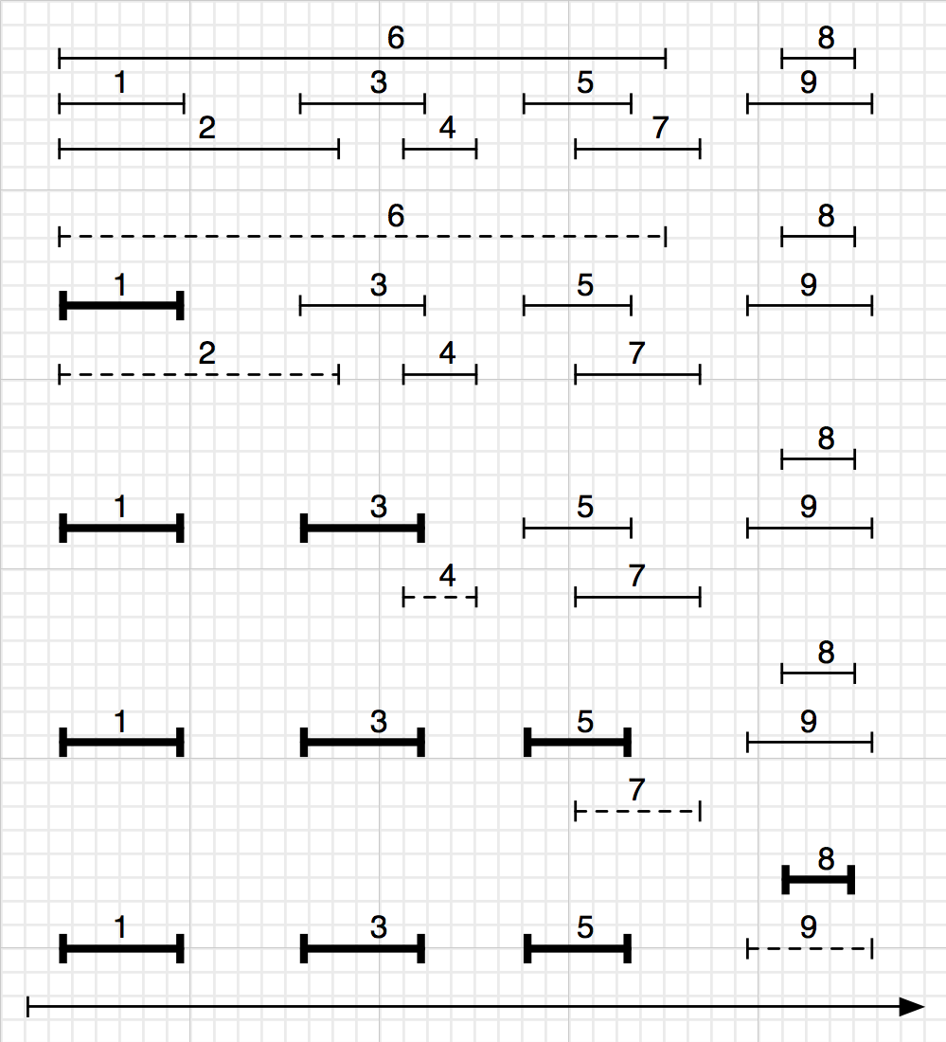
Interval scheduling in action
14 / 38

Slide 37
Interval scheduling in action (continued)
15 / 38

Slide 38
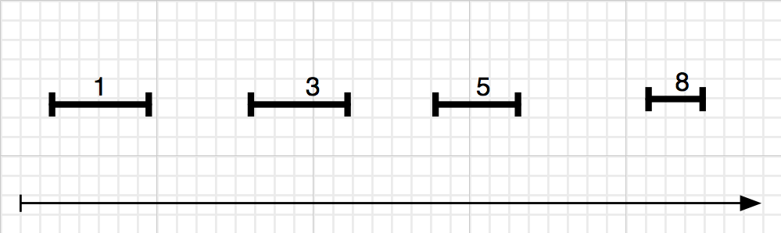
Interval scheduling in action (continued)
15 / 38

Slide 39
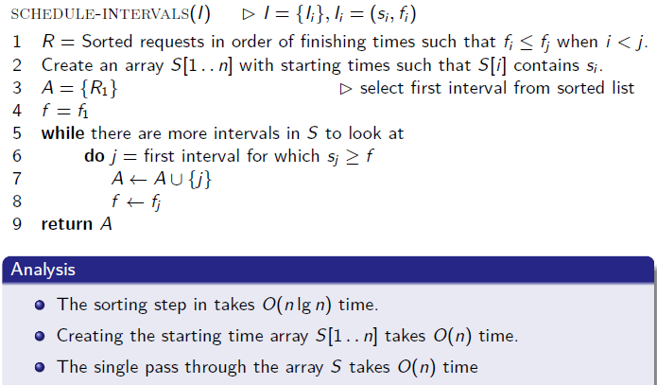
An O(n lg n) greedy algorithm for interval scheduling

Slide 40
Activity Selection a.k.a. Interval Scheduling Problem
Here are a set of start and finish times
i | 1 | 2 | 3 | 4 | 5 | 6 | 7 | 8 | 9 | 10 | 11
S_{j} | 1 | 5 | 0 | 3 | 6 | 5 | 3 | 12 | 8 | 2 | 8
f_{j} | 4 | 7 | 6 | 5 | 10 | 9 | 9 | 16 | 12 | 14 | 11

Slide 41
Activity Selection a.k.a. Interval Scheduling Problem
Here are a set of start and finish times
i | 1 | 2 | 3 | 4 | 5 | 6 | 7 | 8 | 9 | 10 | 11
S_{j} | 1 | 5 | 0 | 3 | 6 | 5 | 3 | 12 | 8 | 2 | 8
f_{j} | 4 | 7 | 6 | 5 | 10 | 9 | 9 | 16 | 12 | 14 | 11
i | 1 | 2 | 3 | 4 | 5 | 6 | 7 | 8 | 9 | 10 | 11
S_{j} | 1 | 3 | 0 | 5 | 3 | 5 | 6 | 8 | 8 | 2 | 12
f_{j} | 4 | 5 | 6 | 7 | 9 | 9 | 10 | 11 | 12 | 14 | 16
{1, 4, 8, 11} which is a larger set (an optimal solution)
Solution is not unique, consider {2, 4, 9, 11} (another optimal solution)

Slide 42
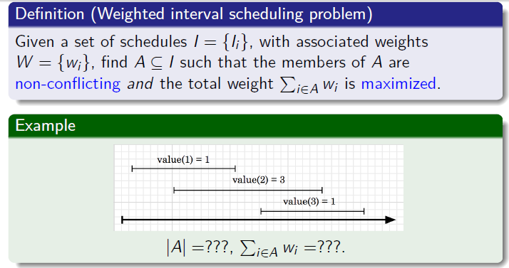
Extension: weighted interval scheduling problem
17 / 38

Slide 43
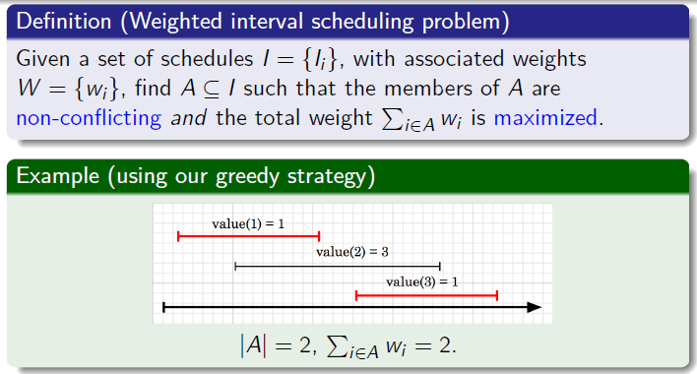
Extension: weighted interval scheduling problem
17 / 38

Slide 44
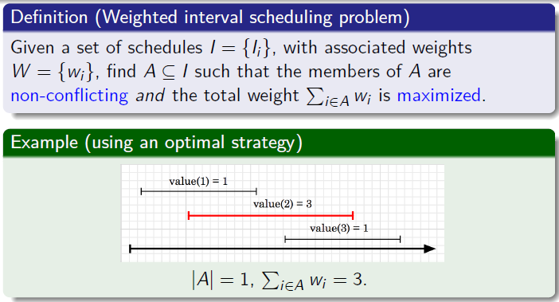
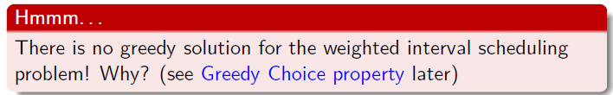
Extension: weighted interval scheduling problem

Slide 45
Greedy algorithms
Coin changing problem
Definition
Given coin denominations in {C }, make change for a given amount
A with the minimum number of coins.
34 / 38

Slide 46
Greedy algorithms
Coin changing problem
Definition
Given coin denominations in {C }, make change for a given amount
A with the minimum number of coins.
Example
Coin denominations, C = {25, 10, 5, 1} Amount to change, A = 73
34 / 38

Slide 47
Greedy algorithms
Coin changing problem
Definition
Given coin denominations in {C }, make change for a given amount
A with the minimum number of coins.
Example
Coin denominations, C = {25, 10
, 5, 1} Amount to change, A = 73
1
Choose 2 25 coins, so remaining is 73 − 2 ∗ 25 = 23
34 / 38

Slide 48
Greedy algorithms
Coin changing problem
Definition
Given coin denominations in {C }, make change for a given amount
A with the minimum number of coins.
Example
Coin denominations, C = {25, 10
, 5, 1} Amount to change, A = 73
Choose 2 25 coins, so remaining is 73 − 2 ∗ 25 = 23
Choose 2 10 coins, so remaining is 23 − 2 ∗ 10 = 3
1
2
34 / 38

Slide 49
Greedy algorithms
Coin changing problem
Definition
Given coin denominations in {C }, make change for a given amount
A with the minimum number of coins.
Example
Coin denominations, C = {25, 10
, 5, 1} Amount to change, A = 73
1
Choose 2 25 coins, so remaining is 73 − 2 ∗ 25 = 23
2
Choose 2 10 coins, so remaining is 23 − 2 ∗ 10 = 3
3
Choose 0 5 coins, so remaining is 3
34 / 38

Slide 50
Greedy algorithms
Coin changing problem
Definition
Given coin denominations in {C }, make change for a given amount
A with the minimum number of coins.
Example
Coin denominations, C = {25, 10
, 5, 1} Amount to change, A = 73
1
Choose 2 25 coins, so remaining is 73 − 2 ∗ 25 = 23
2
Choose 2 10 coins, so remaining is 23 − 2 ∗ 10 = 3
Choose 0 5 coins, so remaining is 3
Choose 3 1 coins, so remaining is 3 − 3 ∗ 1 = 0
3
4
34 / 38

Slide 51
Greedy algorithms
Coin changing problem
Definition
Given coin denominations in {C }, make change for a given amount
A with the minimum number of coins.
Example
Coin denominations, C = {25, 10
, 5, 1} Amount to change, A = 73
1
Choose 2 25 coins, so remaining is 73 − 2 ∗ 25 = 23
2
Choose 2 10 coins, so remaining is 23 − 2 ∗ 10 = 3
3
Choose 0 5 coins, so remaining is 3
4
Choose 3 1 coins, so remaining is 3 − 3 ∗ 1 = 0
Solution (and it’s optimal): 2 × 25 + 2 × 10 + 3 × 1 = 7 coins.
34 / 38

Slide 52
Greedy algorithms
Coin changing problem
Definition
Given coin denominations in {C }, make change for a given amount
A with the minimum number of coins.
Example
Coin denominations, C = {25, 10
, 5, 1} Amount to change, A = 73
1
Choose 2 25 coins, so remaining is 73 − 2 ∗ 25 = 23
2
Choose 2 10 coins, so remaining is 23 − 2 ∗ 10 = 3
3
Choose 0 5 coins, so remaining is 3
4
Choose 3 1 coins, so remaining is 3 − 3 ∗ 1 = 0
Solution (and it’s optimal): 2 × 25 + 2 × 10 + 3 × 1 = 7 coins.
Key question
Does a greedy approach always produce the optimal solution?
34 / 38

Slide 53
Coin changing problem (continued)
Coin denominations, C = {12, 5, 1} Amount to change, A = 15
35 / 38

Slide 54
Coin changing problem (continued)
Coin denominations, C = {12, 5, 1} Amount to change, A = 15 Example (using greedy strategy)
35 / 38

Slide 55
Coin changing problem (continued)
Coin denominations, C = {12, 5, 1} Amount to change, A = 15 Example (using greedy strategy)
1
Choose 1 12 coins, so remaining is 15 − 1 ∗ 12 = 3
35 / 38

Slide 56
Coin changing problem (continued)
Coin denominations, C = {12, 5, 1} Amount to change, A = 15 Example (using greedy strategy)
Choose 1 12 coins, so remaining is 15 − 1 ∗ 12 = 3
Choose 3 1 coins, so remaining is 3 − 1 ∗ 3 = 0
1
2
35 / 38

Slide 57
Coin changing problem (continued)
Coin denominations, C = {12, 5, 1} Amount to change, A = 15 Example (using greedy strategy)
1
Choose 1 12 coins, so remaining is 15 − 1 ∗ 12 = 3
2
Choose 3 1 coins, so remaining is 3 − 1 ∗ 3 = 0
Solution: 4 coins.
35 / 38

Slide 58
Coin changing problem (continued)
Coin denominations, C = {12, 5, 1} Amount to change, A = 15 Example (using greedy strategy)
1
Choose 1 12 coins, so remaining is 15 − 1 ∗ 12 = 3
2
Choose 3 1 coins, so remaining is 3 − 1 ∗ 3 = 0
Solution: 4 coins.
Example (using optimal strategy)
35 / 38

Slide 59
Coin changing problem (continued)
Coin denominations, C = {12, 5, 1} Amount to change, A = 15 Example (using greedy strategy)
1
Choose 1 12 coins, so remaining is 15 − 1 ∗ 12 = 3
2
Choose 3 1 coins, so remaining is 3 − 1 ∗ 3 = 0
Solution: 4 coins.
Example (using optimal strategy)
1
Choose 0 12 coins, so remaining is 15
35 / 38

Slide 60
Coin changing problem (continued)
Coin denominations, C = {12, 5, 1} Amount to change, A = 15 Example (using greedy strategy)
1
Choose 1 12 coins, so remaining is 15 − 1 ∗ 12 = 3
2
Choose 3 1 coins, so remaining is 3 − 1 ∗ 3 = 0
Solution: 4 coins.
Example (using optimal strategy)
Choose 0 12 coins, so remaining is 15
Choose 3 5 coins, so remaining is 15 − 3 ∗ 5 = 0
1
2
35 / 38

Slide 61
Coin changing problem (continued)
Coin denominations, C = {12, 5, 1} Amount to change, A = 15 Example (using greedy strategy)
1
Choose 1 12 coins, so remaining is 15 − 1 ∗ 12 = 3
2
Choose 3 1 coins, so remaining is 3 − 1 ∗ 3 = 0
Solution: 4 coins.
Example (using optimal strategy)
1
Choose 0 12 coins, so remaining is 15
2
Choose 3 5 coins, so remaining is 15 − 3 ∗ 5 = 0
Solution: 3 coins.
35 / 38

Slide 62
Coin changing problem (continued)
Coin denominations, C = {12, 5, 1} Amount to change, A = 15 Example (using greedy strategy)
1
Choose 1 12 coins, so remaining is 15 − 1 ∗ 12 = 3
2
Choose 3 1 coins, so remaining is 3 − 1 ∗ 3 = 0
Solution: 4 coins.
Example (using optimal strategy)
1
Choose 0 12 coins, so remaining is 15
2
Choose 3 5 coins, so remaining is 15 − 3 ∗ 5 = 0
Solution: 3 coins.
Key observation
Correctness depends on the choice of coins, so greedy strategy does not provide a general solution to this problem!
35 / 38

Slide 63
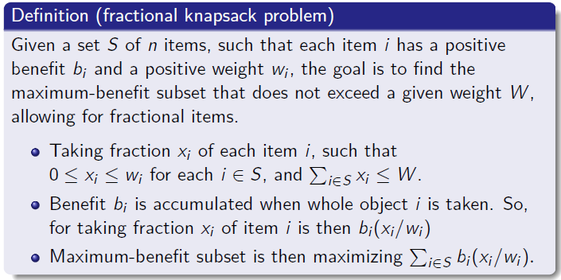
Greedy algorithms
Fractional knapsack problem
23 / 38

Slide 64
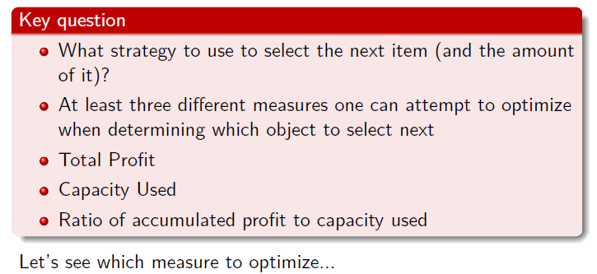
Greedy algorithms
Fractional knapsack problem
24 / 38

Slide 65
Greedy algorithms
Fractional knapsack problem
Item | Benefit | Weight
A | 25 | 18 kg
B | 15 | 10 kg
C | 24 | 15 kg
Capacity W=20
25 / 38

Slide 66
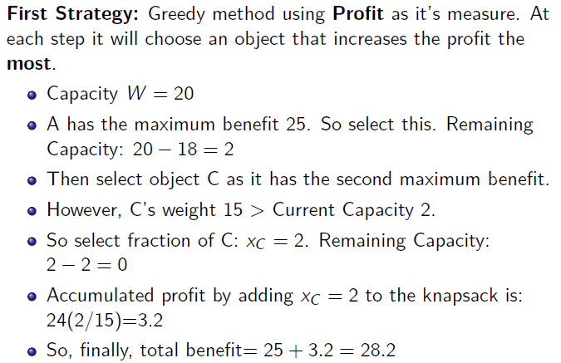
Fractional knapsack problem
Item | Benefit | Weight
A | 25 | 18 kg
B | 15 | 10 kg
C | 24 | 15 kg
26 / 38

Slide 67
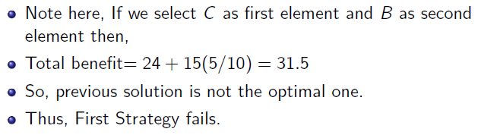
Fractional knapsack problem
Item | Benefit | Weight
A | 25 | 18 kg
B | 15 | 10 kg
C | 24 | 15 kg
27 / 38

Slide 68
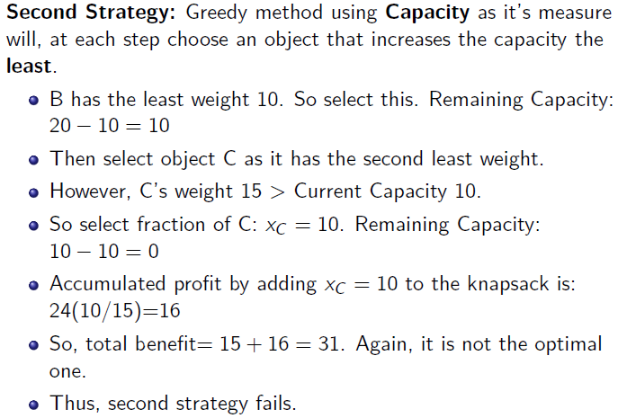
Fractional knapsack problem
Item | Benefit | Weight
A | 25 | 18 kg
B | 15 | 10 kg
C | 24 | 15 kg
28 / 38

Slide 69
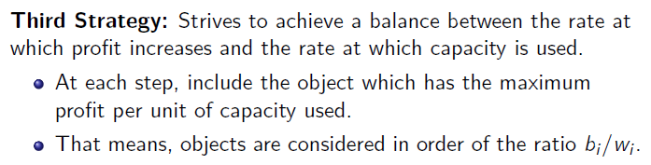
Fractional knapsack problem
Item | Benefit | Weight
A | 25 | 18 kg
B | 15 | 10 kg
C | 24 | 15 kg
Item | Benefit | Weight | Ratio
A | 25 | 18 kg | 25/18 = 1.4
B | 15 | 10 kg | 15/10 = 1.5
C | 24 | 15 kg | 24/15 = 1.6

Slide 70
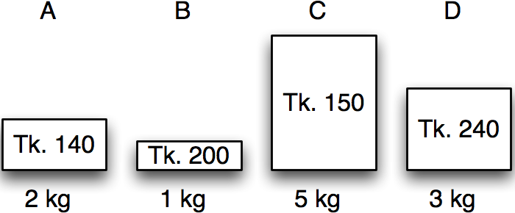
Greedy algorithms
Fractional knapsack in action
Item | Benefit | Weight
A | 140 | 2 kg
B | 200 | 1 kg
C | 150 | 5 kg
D | 240 | 3 kg
Calculate benefit/kg – the value index.

Slide 71
Greedy algorithms
Fractional knapsack in action
Item | Benefit | Weight | Value index
A | 140 | 2 kg | 70
B | 200 | 1 kg | 200
C | 150 | 5 kg | 30
D | 240 | 3 kg | 80
Sort by non-increasing value index.
Licensed under
30 / 38

Slide 72
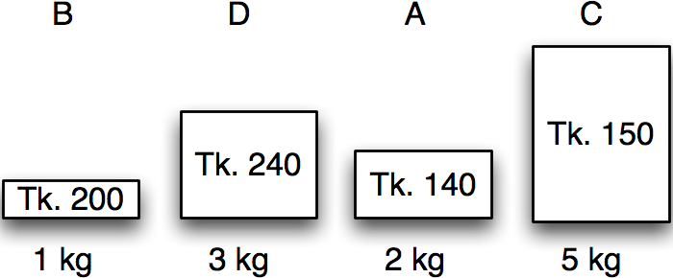
Greedy algorithms
Fractional knapsack in action
Item | Benefit | Weight | Value index
B | 200 | 1 kg | 200
D | 240 | 3 kg | 80
A | 140 | 2 kg | 70
C | 150 | 5 kg | 30
Maximum weight:
5 kg
30 / 38

Slide 73
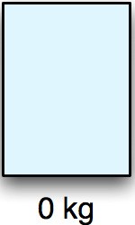
Greedy algorithms
Fractional knapsack in action
Item | Benefit | Weight | Value index | Chosen
B | 200 | 1 kg | 200 | 0 kg
D | 240 | 3 kg | 80 | 0 kg
A | 140 | 2 kg | 70 | 0 kg
C | 150 | 5 kg | 30 | 0 kg
Maximum weight:
5 kg
Remaining:
5 kg
Benefit:
0 kg
30 / 38

Slide 74
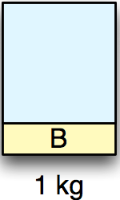
Greedy algorithms
Fractional knapsack in action
Item | Benefit | Weight | Value index | Chosen
B | 200 | 1 kg | 200 | 1 kg
D | 240 | 3 kg | 80 | 0 kg
A | 140 | 2 kg | 70 | 0 kg
C | 150 | 5 kg | 30 | 0 kg
Maximum weight:
5 kg
Remaining:
4 kg
Benefit:
200 kg
30 / 38

Slide 75
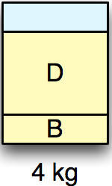
Greedy algorithms
Fractional knapsack in action
Item | Benefit | Weight | Value index | Chosen
B | 200 | 1 kg | 200 | 1 kg
D | 240 | 3 kg | 80 | 3 kg
A | 140 | 2 kg | 70 | 0 kg
C | 150 | 5 kg | 30 | 0 kg
Maximum weight:
5 kg
Remaining:
1 kg
Benefit:
440 kg
30 / 38

Slide 76
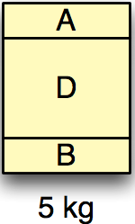
Greedy algorithms
Fractional knapsack in action
Item | Benefit | Weight | Value index | Chosen
B | 200 | 1 kg | 200 | 1 kg
D | 240 | 3 kg | 80 | 3 kg
A | 140 | 2 kg | 70 | 1 kg
C | 150 | 5 kg | 30 | 0 kg
Maximum weight:
5 kg
Remaining:
0 kg
Benefit:
510 kg
30 / 38

Slide 77
Greedy algorithms
Fractional knapsack in action
Item | Benefit | Weight | Value index | Chosen
B | 200 | 1 kg | 200 | 1 kg
D | 240 | 3 kg | 80 | 3 kg
A | 140 | 2 kg | 70 | 1 kg
C | 150 | 5 kg | 30 | 0 kg
Maximum weight:
5 kg
Remaining:
0 kg
Benefit:
510 kg
30 / 38

Slide 78
The Fractional Knapsack Problem
Given: A set S of n items, with each item i having
b_{i} - a positive benefit
w_{i} - a positive weight
Goal: Choose items with maximum total benefit but with weight at most W.
“knapsack”
Solution: P
1 ml of 5 50$
2 ml of 3 40$
6 ml of 4 30$
1 ml of 2 4$
Total Profit:124$
Items:
1
2
3
4
5
Weight:
4 ml
8 ml
2 ml
6 ml
1 ml
Benefit:
$12
$32
$40
$30
$50
10 ml
Value:
3
4
20
5
50
($ per ml)

Slide 79
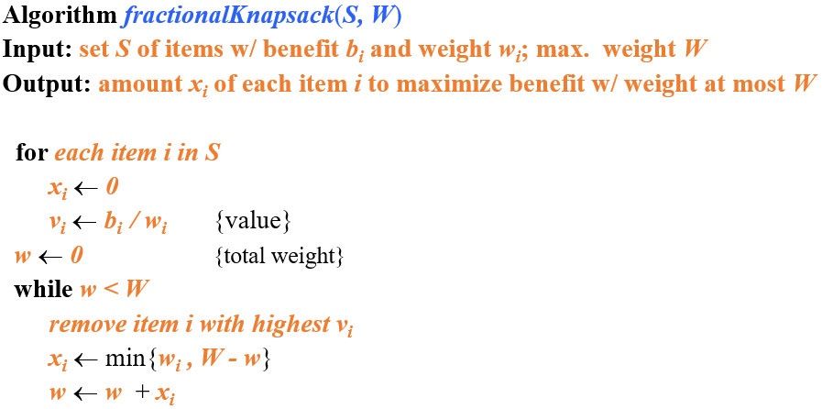
Fractional knapsack greedy algorithm

Slide 80
The Fractional Knapsack Algorithm
Running time:
Given a collection S of n items, such that each item i has a benefit b_{i} and weight w_{i}, we can construct a maximum-benefit subset of S, allowing for fractional amounts, that has a total weight W in O(nlogn) time. (how?)
Use heap-based priority queue to store S
Removing the item with the highest value takes O(logn) time
In the worst case, need to remove all items

Slide 81
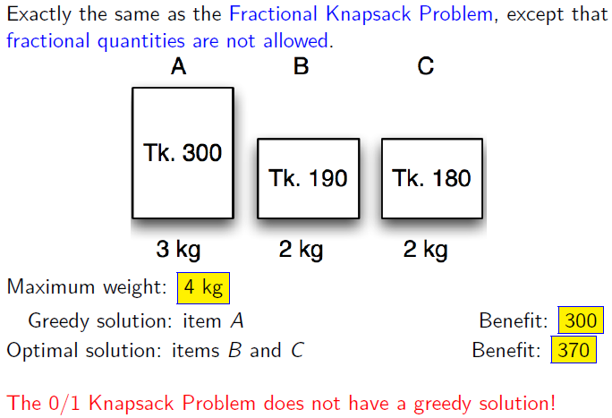
Extension: 0/1 knapsack problem

Slide 82
Huffman Codes
Widely used technique for data compression
Assume the data to be a sequence of characters
Looking for an effective way of storing the data
Binary character code
Uniquely represents a character by a binary string

Slide 83
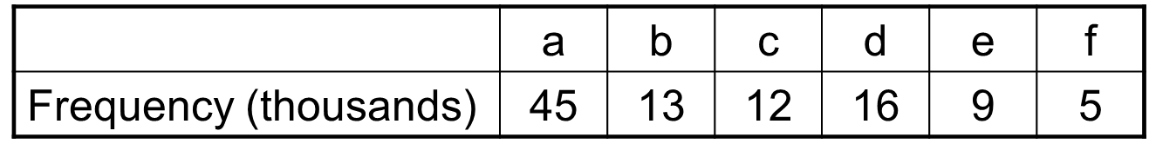
Fixed-Length Codes
E.g.: Data file containing 100,000 characters
3 bits needed
a = 000, b = 001, c = 010, d = 011, e = 100, f = 101
Requires: 100,000 ⋅ 3 = 300,000 bits

Slide 84
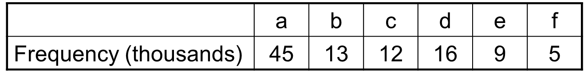
Huffman Codes
Idea:
Use the frequencies of occurrence of characters to build a optimal way of representing each character

Slide 85
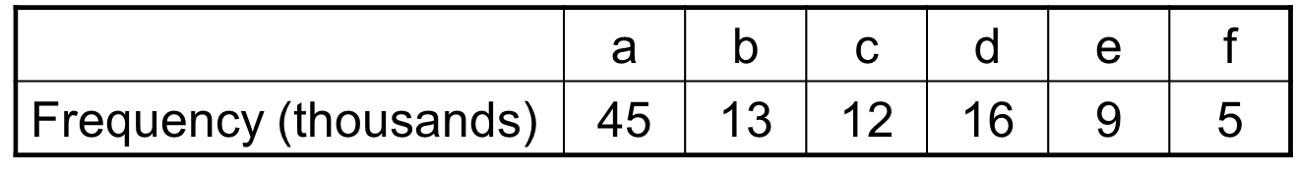
Variable-Length Codes
E.g.: Data file containing 100,000 characters
Assign short codewords to frequent characters and long codewords to infrequent characters
a = 0, b = 101, c = 100, d = 111, e = 1101, f = 1100
(45 ⋅ 1 + 13 ⋅ 3 + 12 ⋅ 3 + 16 ⋅ 3 + 9 ⋅ 4 + 5 ⋅ 4)⋅ 1,000
= 224,000 bits

Slide 86
Prefix Codes
Prefix codes:
Codes for which no codeword is also a prefix of some other codeword
Better name would be “prefix-free codes”
We can achieve optimal data compression using prefix codes
We will restrict our attention to prefix codes

Slide 87
Encoding with Binary Character Codes
Encoding
Concatenate the codewords representing each character in the file
E.g.:
a = 0, b = 101, c = 100, d = 111, e = 1101, f = 1100
abc = 0 ⋅ 101 ⋅ 100 = 0101100

Slide 88
Decoding with Binary Character Codes
Prefix codes simplify decoding
No codeword is a prefix of another ⇒ the codeword that begins an encoded file is unambiguous
Approach
Identify the initial codeword
Translate it back to the original character
Repeat the process on the remainder of the file
E.g.:
a = 0, b = 101, c = 100, d = 111, e = 1101, f = 1100
001011101 =
0
⋅ 0
⋅ 101
⋅ 1101
= aabe

Slide 89

Constructing a Huffman Code
A greedy algorithm that constructs an optimal prefix code called a Huffman code
Assume that:
C is a set of n characters
Each character has a frequency f(c)
The tree T is built in a bottom up manner
Left means ‘0’, right means ‘1’
More frequent characters will be higher in the tree
Idea:
Start with a set of |C| leaves
At each step, merge the two least frequent objects: the frequency of the new node = sum of two frequencies
Use a min-priority queue Q, keyed on f to identify the two least frequent objects

Slide 90
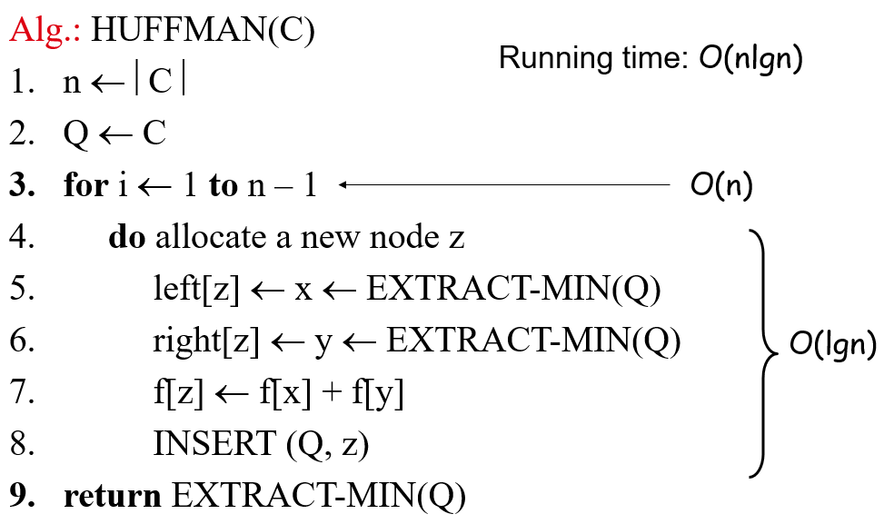
Constructing a Huffman tree

Slide 91
Example

Slide 92
Example
f: 5
e: 9
c: 12
b: 13
d: 16
a: 45
c: 12
b: 13
14
d: 16
a: 45
0
1
f: 5
e: 9
14
d: 16
25
a: 45
25
30
a: 45
0
1
0
1
0
1
0
1
f: 5
e: 9
c: 12
b: 13
c: 12
b: 13
14
d: 16
0
1
f: 5
e: 9
55
0
100
1
a: 45
1
0
a: 45
55
25
30
0
1
0
1
0
1
25
30
c: 12
b: 13
14
d: 16
0
1
0
1
0
1
c: 12
b: 13
14
d: 16
f: 5
e: 9
0
1
f: 5
e: 9

Slide 93
Huffman encoding/decoding using Huffman tree
Encoding:
Construct Huffman tree using the previous algorithm
Traverse the Huffman tree to assign a code to each leaf (representing an input character )
Use these codes to encode the file
Decoding:
Construct Huffman tree using the previous algorithm
Traverse the Huffman tree according to the bits you encounter until you reach a leaf node at which point you output the character represented by that leaf node.
Continue in this fashion until all the bits in the file are read.

Slide 94
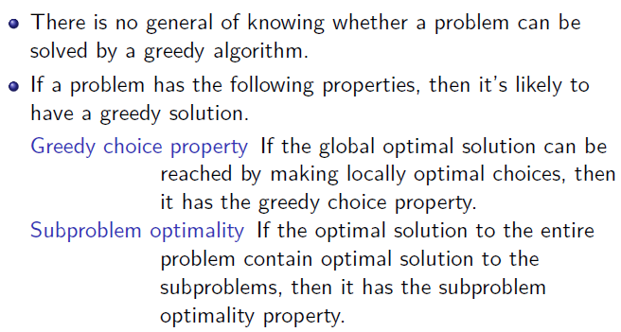
Problem types solved by greedy algorithms

Slide 95
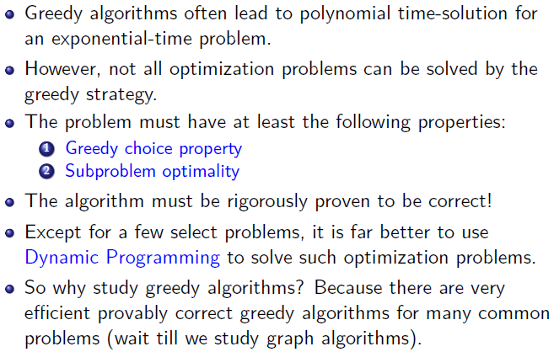
Conclusion
38 / 38

